Slide 1

Mining New York City
Airbnb Listings
Husna Sayedi, Shahab Geravesh, Kevin Vega (Avengers)

Slide 2

K-Means Clustering Background
K-Means Clustering is an unsupervised machine learning algorithm commonly used for data mining
A cluster is a collection of data objects which are similar or related to one another within a group
Cluster Analysis involves finding similarities between data according to characteristics found within the groupings
Clustering can be used as a preprocessing step for other algorithms or it can be used as a stand-alone tool to gain insight into data distributions
Good clusters include 2 main things:
High intra-class similarity, which means cohesiveness within clusters, and
Low inter-class similarity which stresses distinctness between clusters
There are 3 kinds of clustering approaches: partitional, hierarchical, and density-based
K-Means is a partitional clustering approach

Slide 3
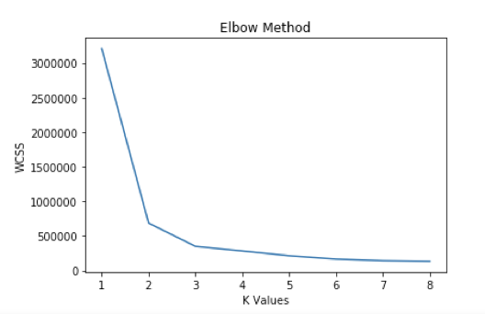
Elbow Method - Determine K
The elbow method is used to determine the number of clusters
For each K value, Within-Cluster-Sum-of-Squares (WCSS) is calculated and plotted against different values for K, in our case 8
The abrupt changes between 2 to 4 clusters suggest those are the optimal K values

Slide 4
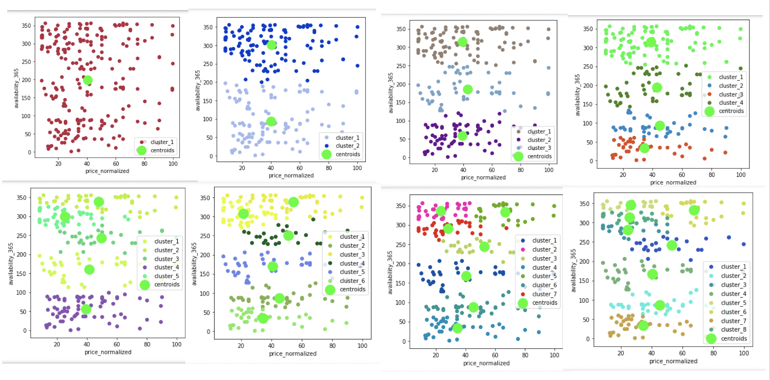
K-Means Clustering
Notes:
These plots show the K-Means Algorithm output, each has 100 iterations and 8 different K values
The mean of each cluster is recalculated to recompute each centroid
The green large dots represent the centroids
We can see how the data is being portioned into different clusters as the K increases

Slide 5
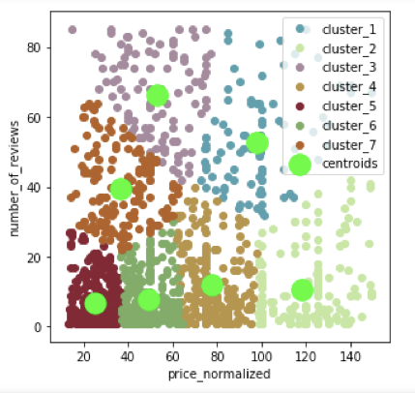
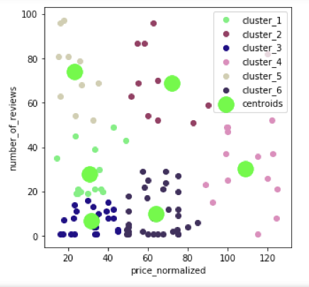
K-Means Results
Notes:
These two plots are shown to see if we can find any natural groupings of listings using the features price and number of reviews
The plot on the left is a subset of data for the queens neighbourhood group while the plot on the right is a subset of data that represents the staten island neighbourhood group
We can see that there are cheaper listings have more reviews, while the more expensive listings have fewer reviews in both plots.

Slide 6
Neural Networks
Can be applied to both supervised and unsupervised problems
Seek to emulate biological systems to solve problems, especially good for non-linear cases
Can be adapted to classify or predict a value
Composed of a graph, information passes through layers, the connections between those layers are assigned weights. The algorithm works by minimizing error (or loss)
Connections which delivered a more correct answer are given more weight
Tune number of layers and number of neurons per layer

Slide 7
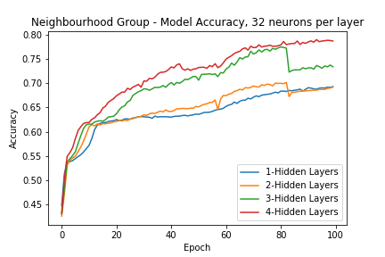
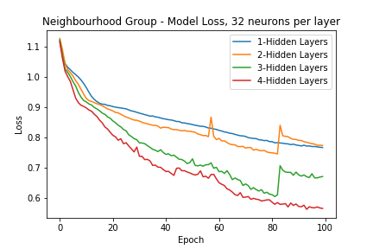
Neural Networks

Slide 8
Dimensionality Reduction Factor Analysis
The main purpose of factor analysis is to group similar observed variables into dimensions. It simplifies the dataset by reducing the dimensions.
Factor Analysis is an unsupervised Machine Learning algorithm
There are 2 types of Factor Analysis:
Exploratory
Confirmatory

Slide 9
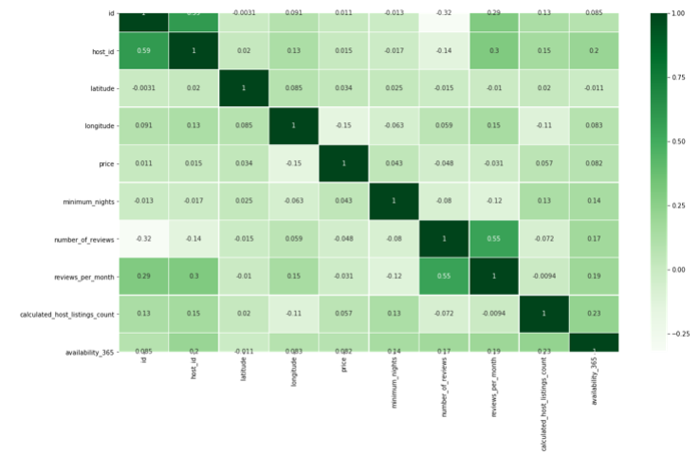
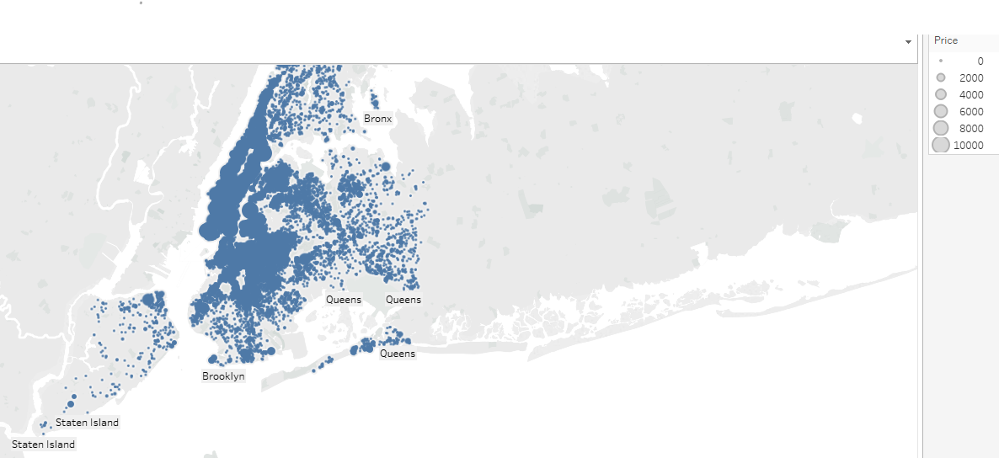
Scatter Plot and Correlation Matrix

Slide 10
